Slide 1
2011 – a year in review
MALTA ROCK CLIMBING CLUB

Slide 2
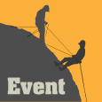
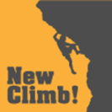
WHAT HAVE WE DONE IN 2011?
Environmental and Access Work
Beginners’ Sessions
Trip to Chamonix, France
Bolting Work and New Routing
Photoshoots, Newspapers & Film
Website & New Facebook Group
Relationship Building with Stakeholders

Slide 3
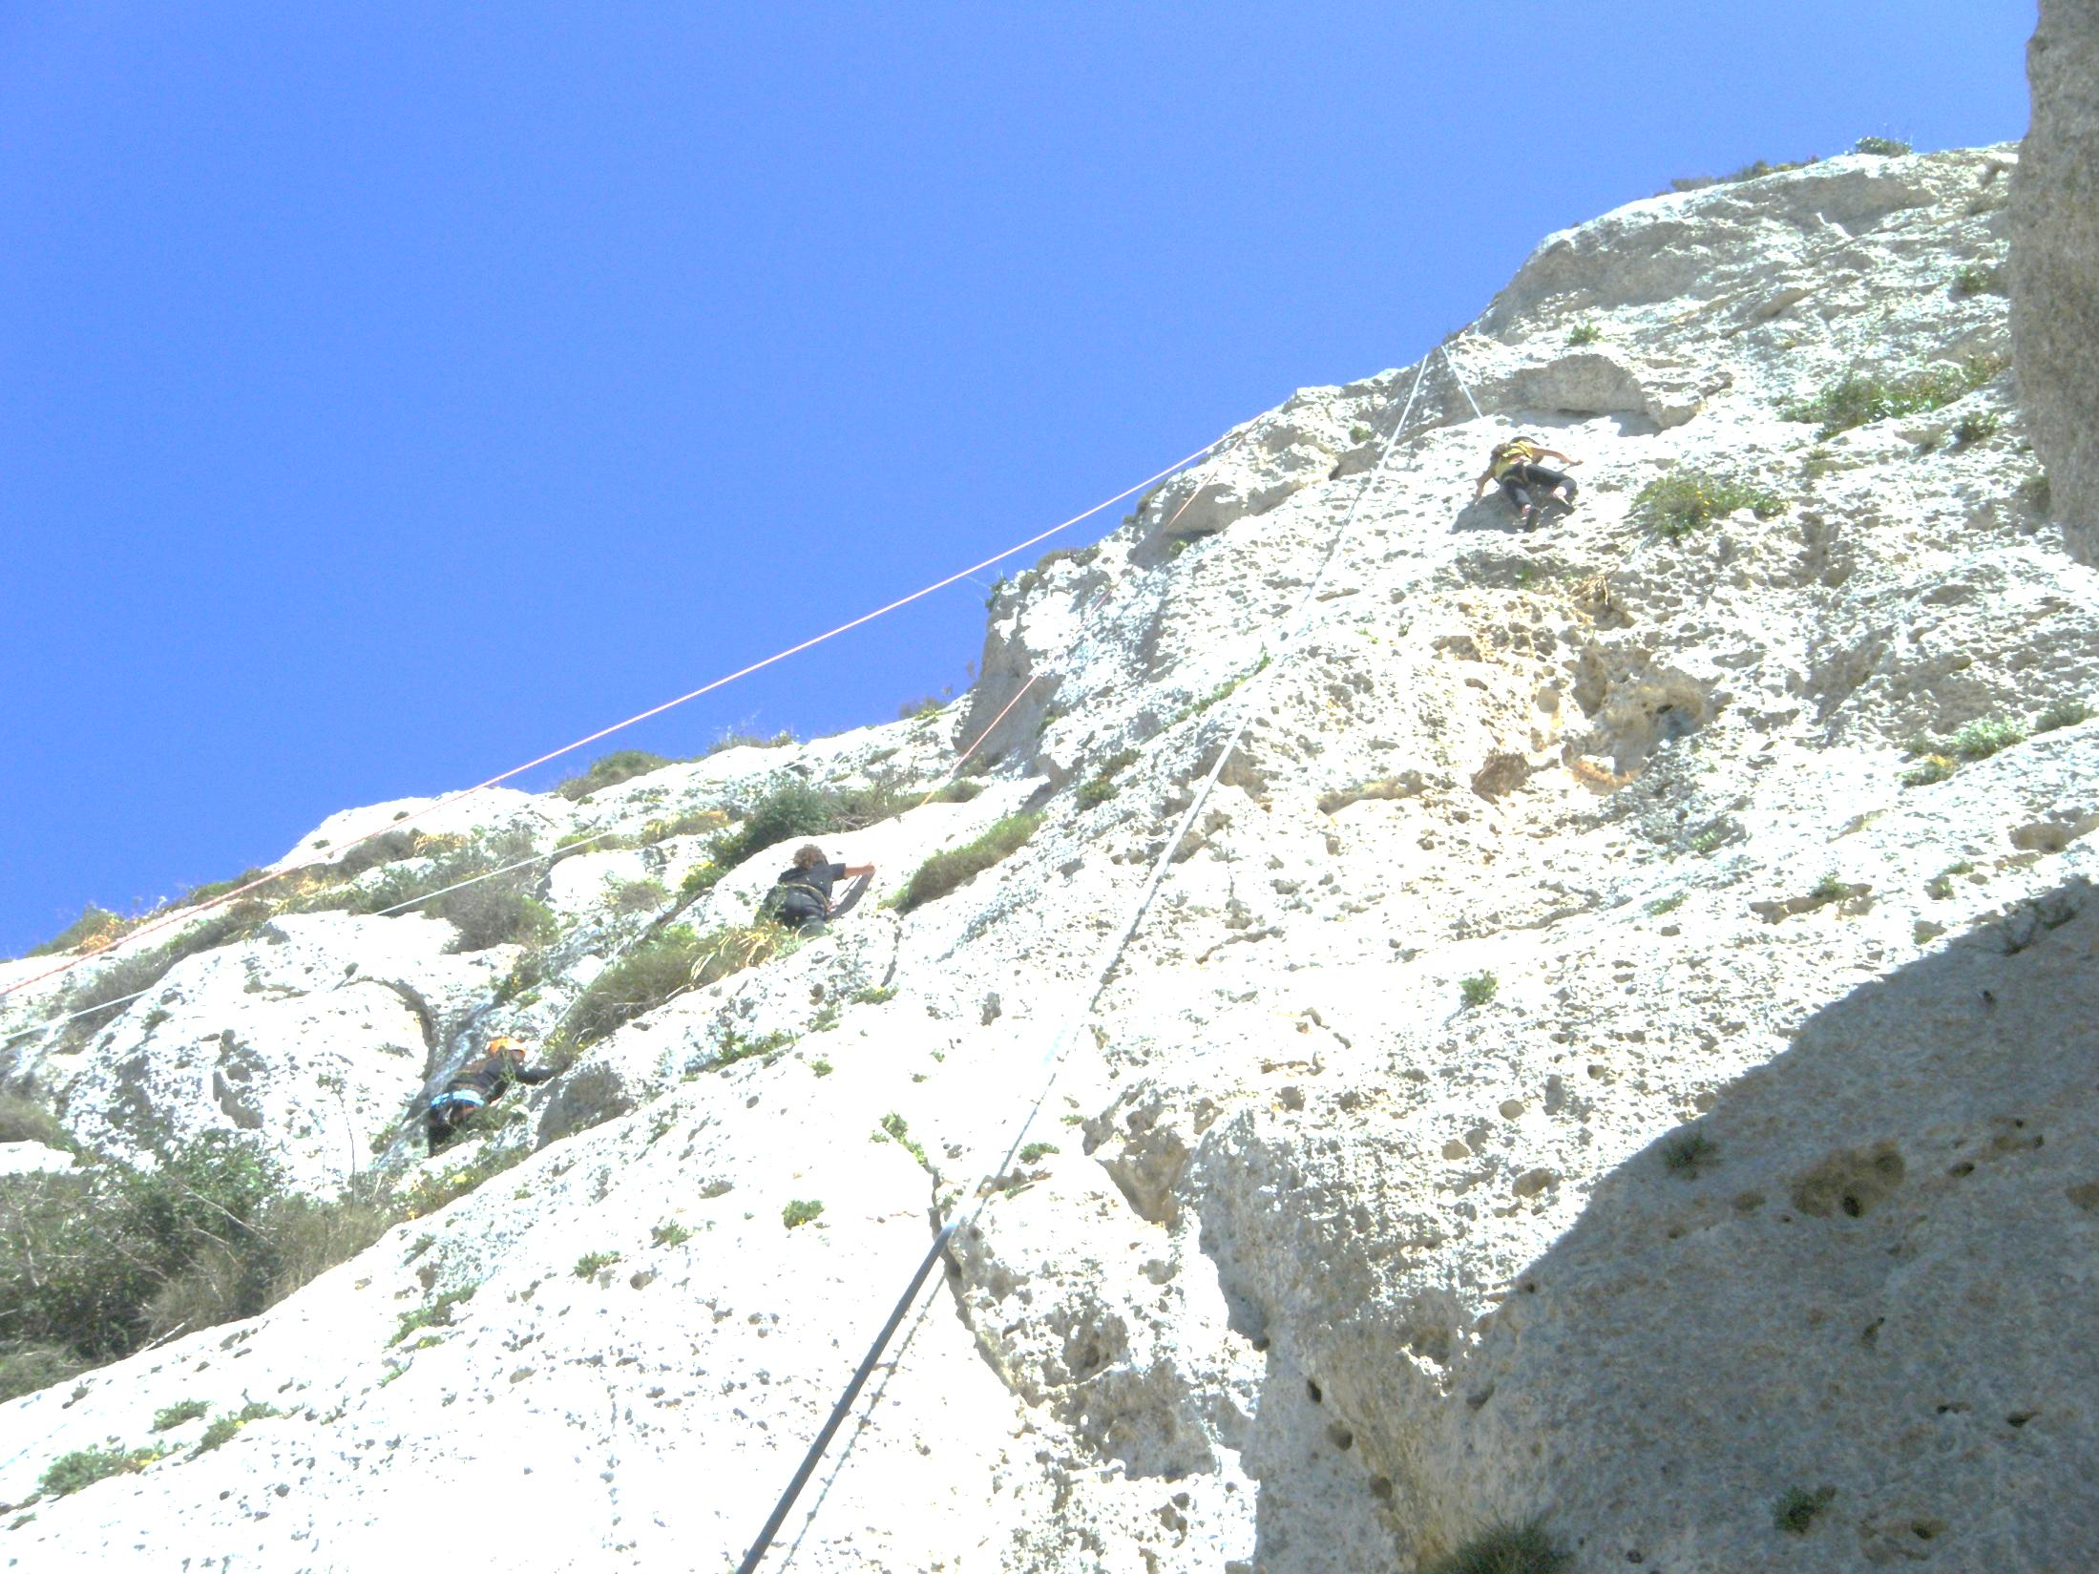
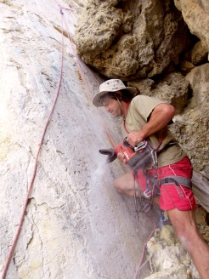
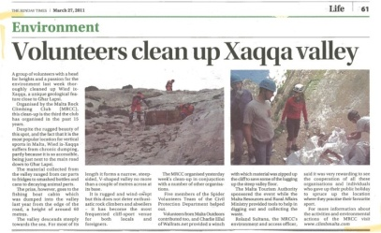
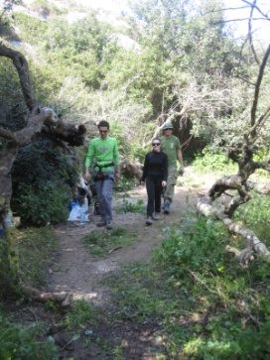
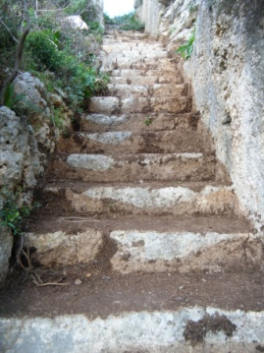
Environmental and Access Work
Xaqqa Valley Access Ladder
Xaqqa Valley Clean-up
Chainsaw Access Work in Wied Babu
Wied il-Għasel Access Work

Slide 4
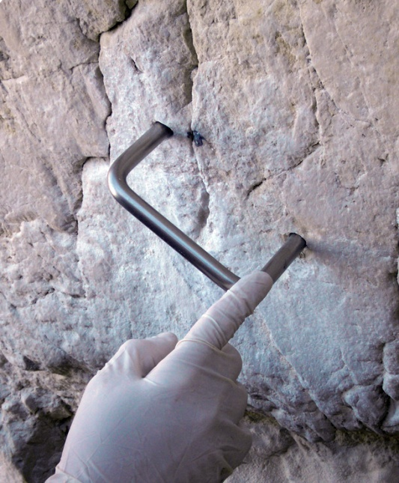
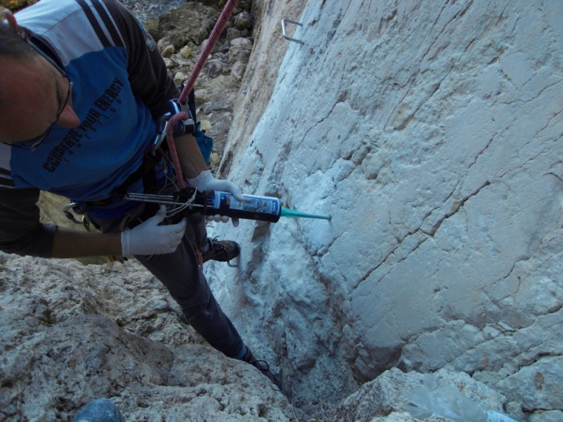
Environmental and Access Work
Xaqqa Valley Access Ladder

Slide 5
Xaqqa Valley Clean-up

Slide 6
Xaqqa Valley Clean-up

Slide 7
Xaqqa Valley Clean-up

Slide 8
Xaqqa Valley Clean-up

Slide 9
Xaqqa Valley Clean-up

Slide 10
Xaqqa Valley Clean-up

Slide 11
Xaqqa Valley Clean-up

Slide 12
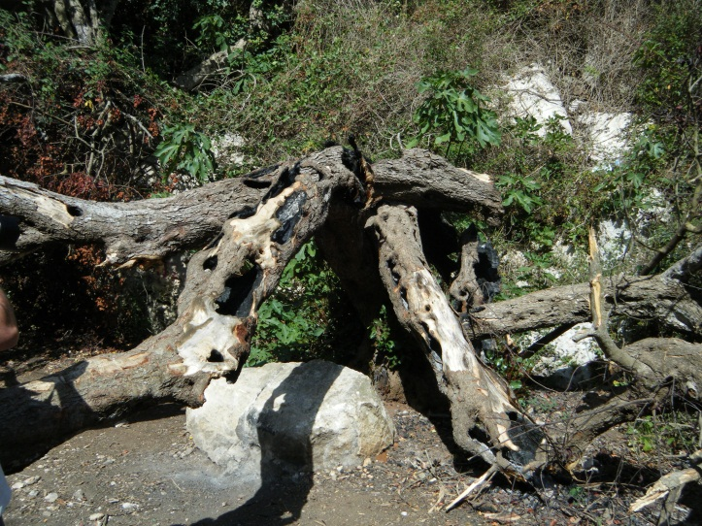
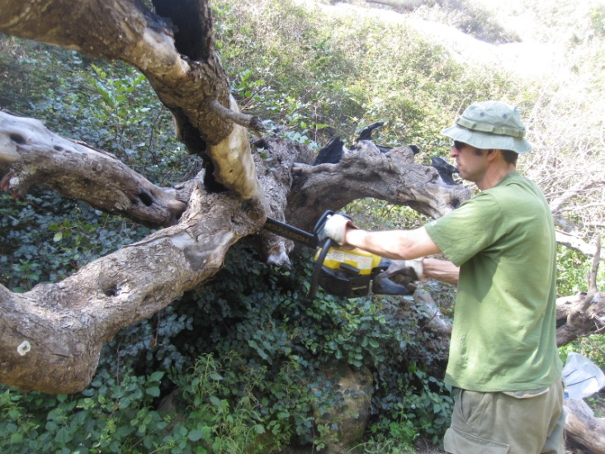
Environmental and Access Work
Chainsaw Access Work in Wied Babu

Slide 13
Wied il-Għasel Access Work

Slide 14
Wied il-Għasel Access Work

Slide 15
Wied il-Għasel Access Work

Slide 16
Wied il-Għasel Access Work

Slide 17
Wied il-Għasel Access Work

Slide 18
Wied il-Għasel Access Work

Slide 19
Wied il-Għasel Access Work

Slide 20
Wied il-Għasel Access Work

Slide 21
Wied il-Għasel Access Work

Slide 22
Wied il-Għasel Access Work

Slide 23
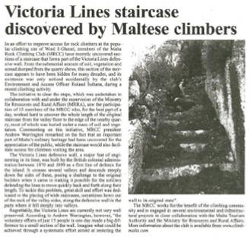
Wied il-Għasel Access Work

Slide 24
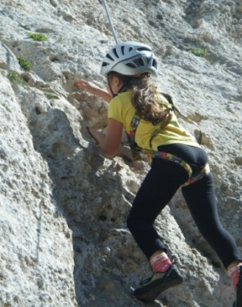
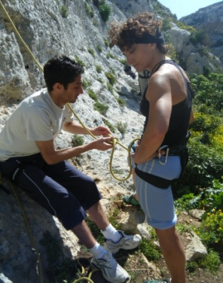
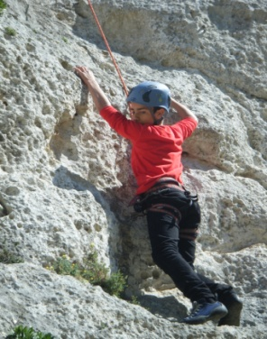
Beginners’ Sessions
15 Beginners’ Sessions in 2011
55-60 New Club members
First session of leading instruction
First Basic Rock Climbing Course
First Gozo Beginners’ Session

Slide 25
Beginners’ Sessions

Slide 26
Beginners’ Sessions

Slide 27
Beginners’ Sessions

Slide 28
Beginners’ Sessions

Slide 29
Beginners’ Sessions

Slide 30
Beginners’ Sessions

Slide 31
Beginners’ Sessions

Slide 32
Beginners’ Sessions

Slide 33
Beginners’ Sessions

Slide 34
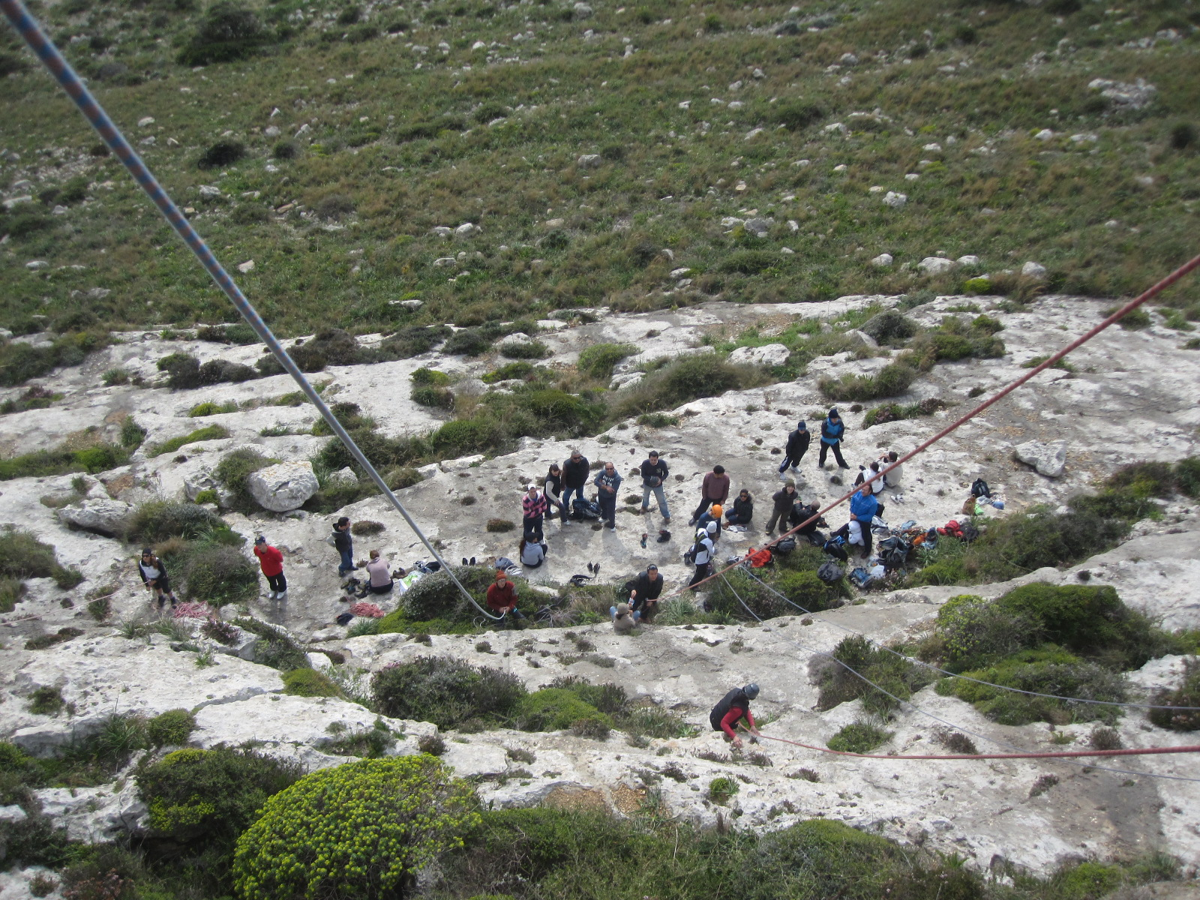
Beginners’ Sessions

Slide 35
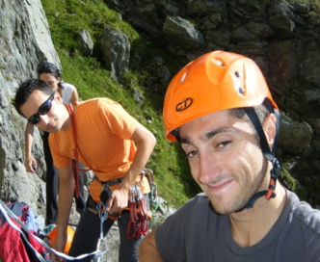
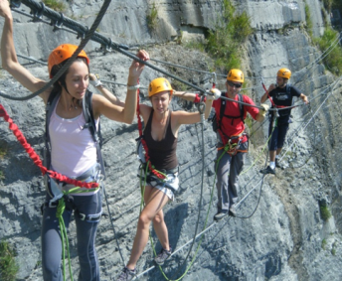
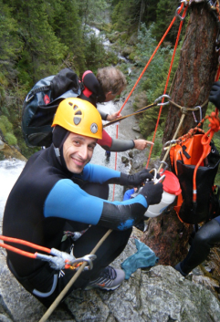
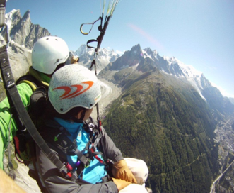
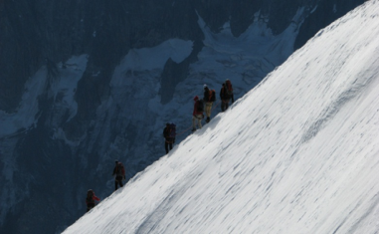
Trip to Chamonix, France
Paragliding
Canyoning
Multi-pitch rock climbing
Mountain walking and glacier travel
Via Ferrata
Hydrospeed
Mountainbiking

Slide 36
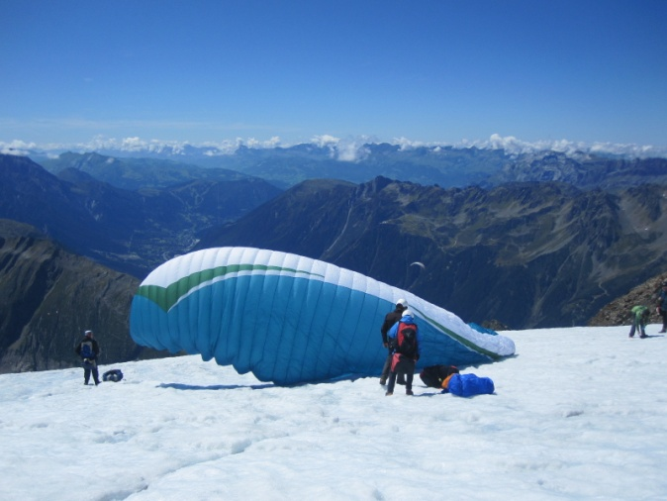
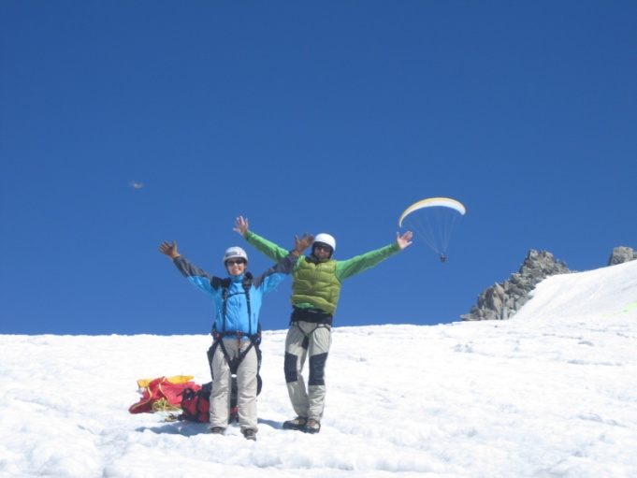
Trip to Chamonix, France
Paragliding

Slide 37
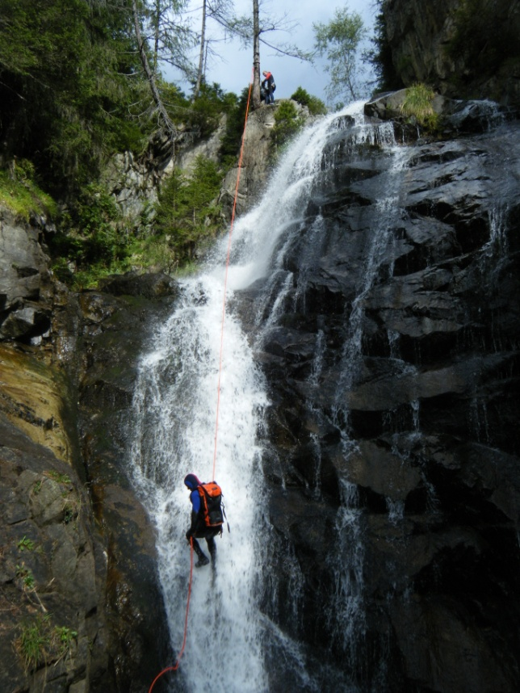
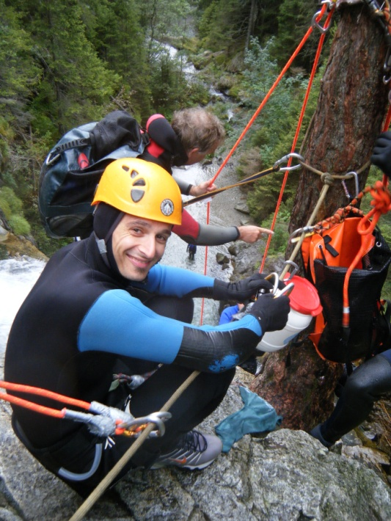
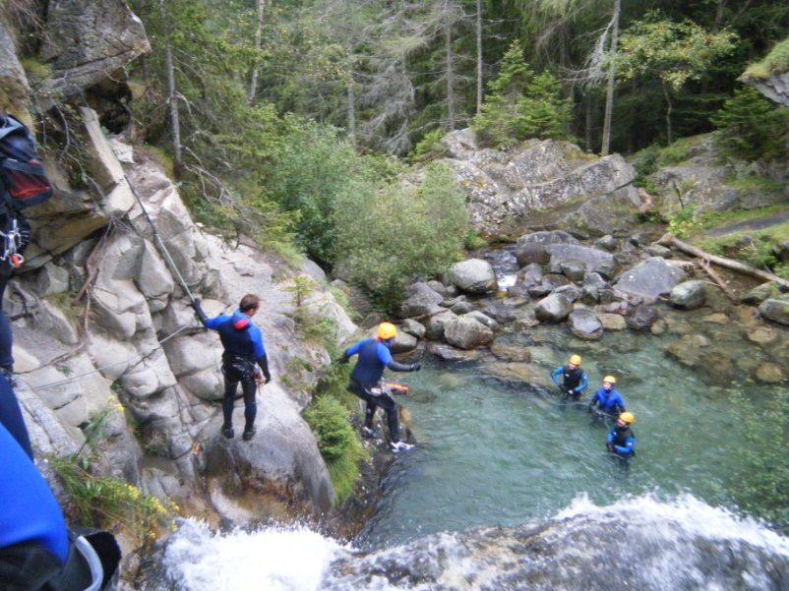
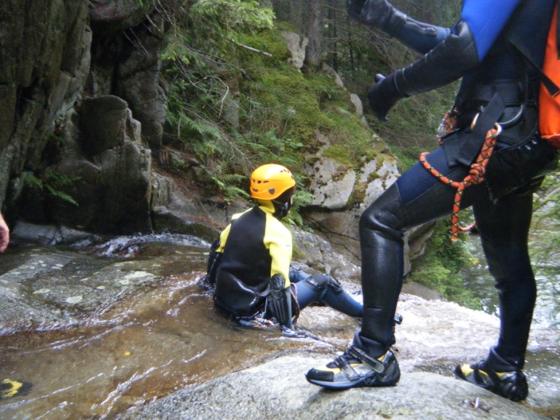
Trip to Chamonix, France
Canyoning

Slide 38
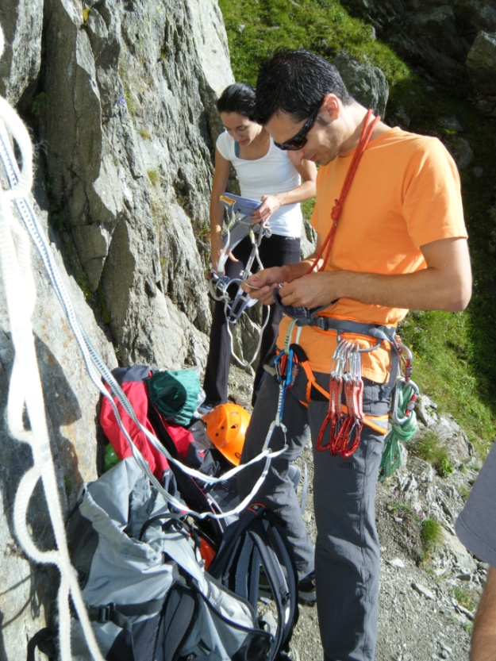
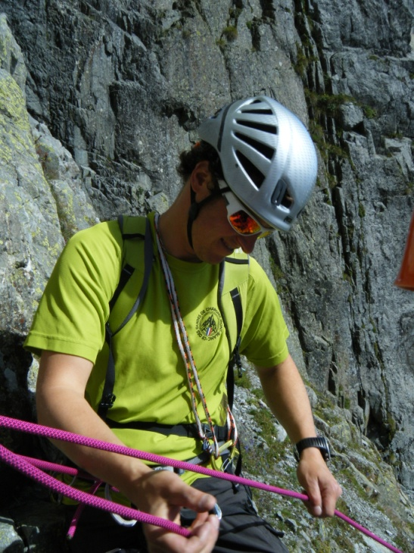
Trip to Chamonix, France
Multi-pitch rock climbing

Slide 39
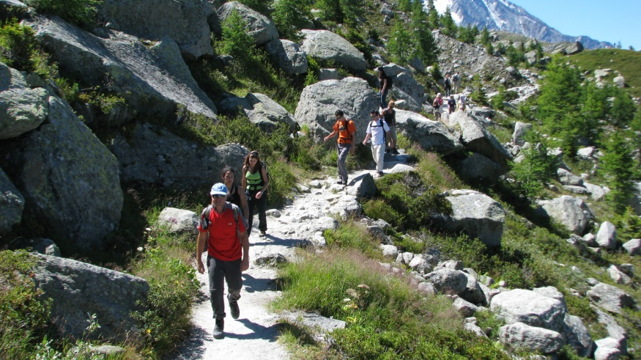
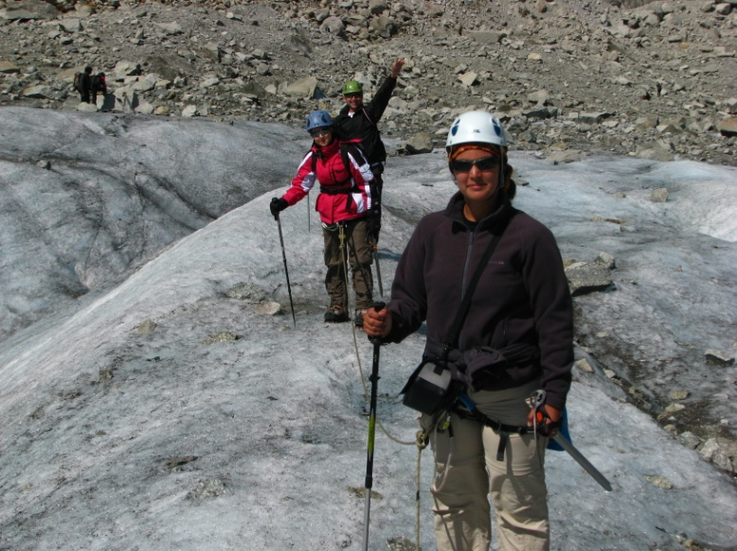
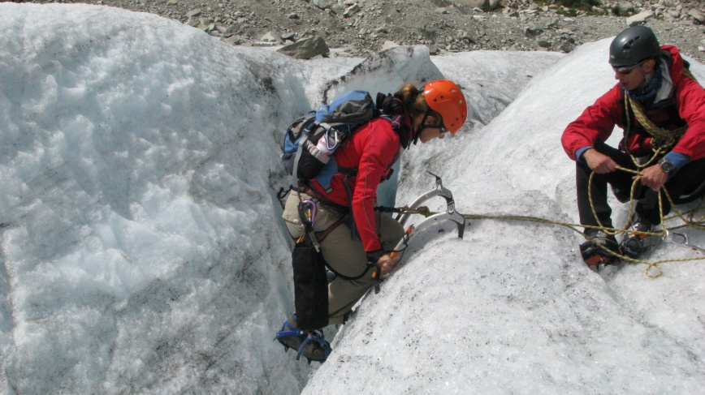
Trip to Chamonix, France
Mountain walking and glacier travel

Slide 40
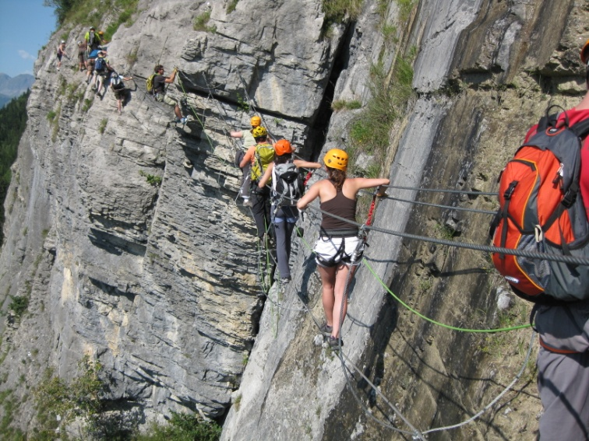
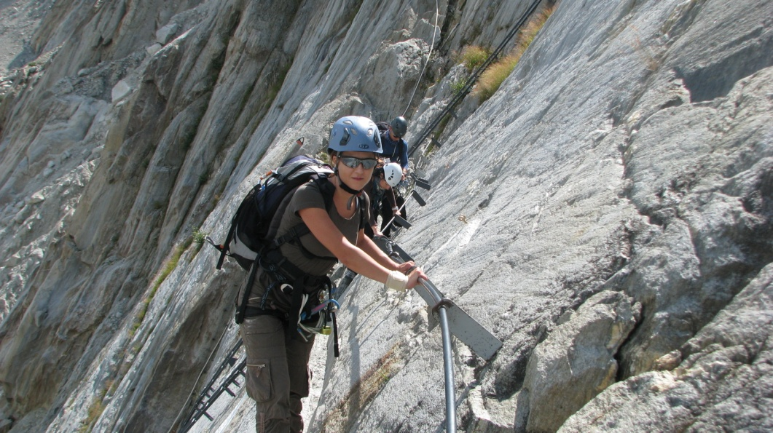
Trip to Chamonix, France
Via Ferrata

Slide 41
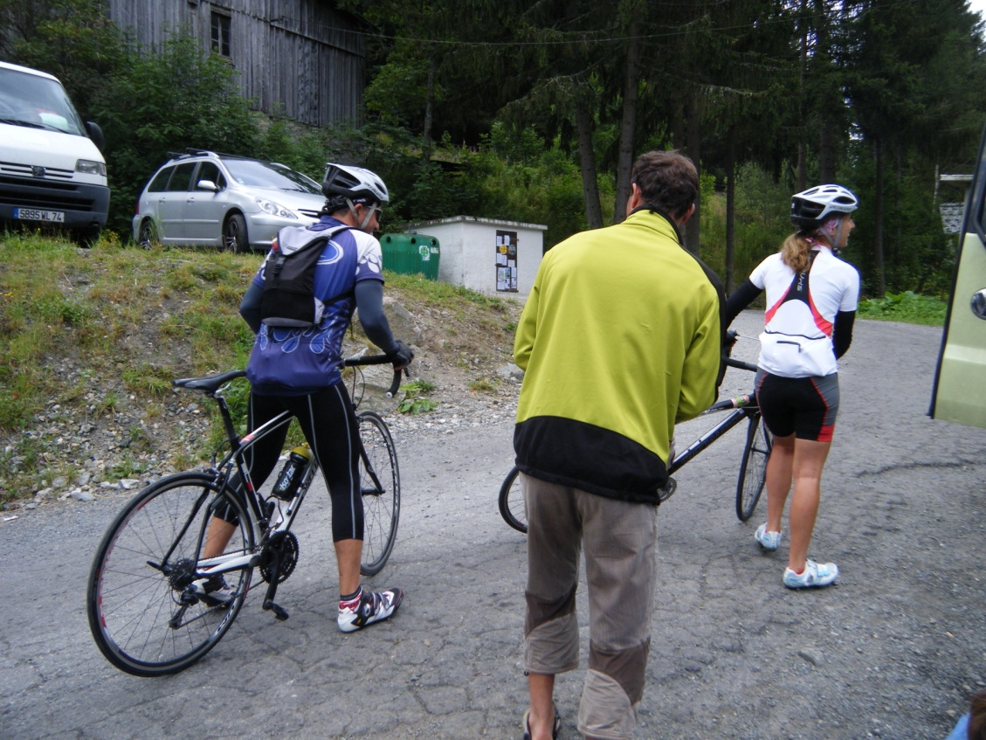
Trip to Chamonix, France
Mountainbiking

Slide 42
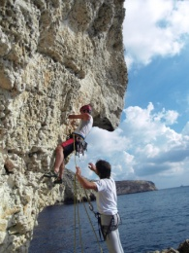
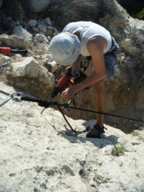
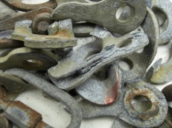
Bolting Work and New Routing
12 New Routes in 2011: 6 sport / 6 trad
Lower-offs installed on 43 routes
90+ bolts installed by MRCC Bolting Team
50+ MTA-MRCC bolts installed by other local climbers

Slide 43
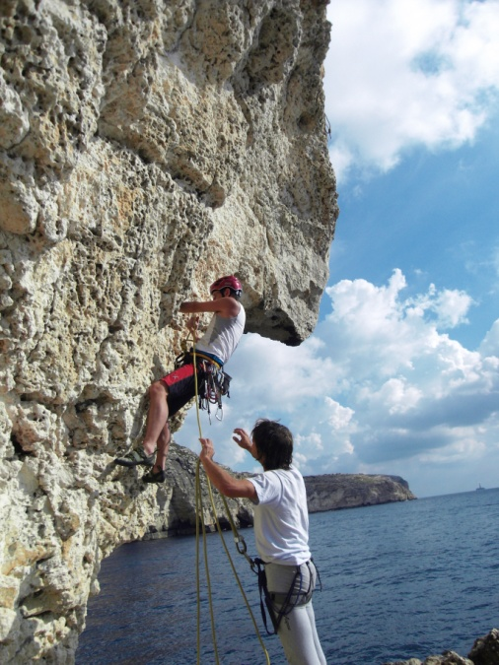
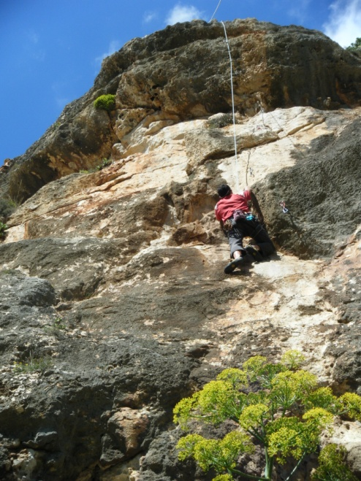
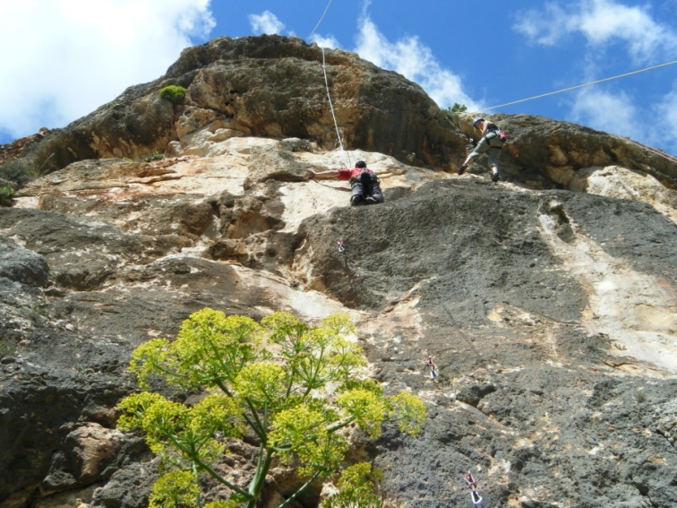
Bolting Work and New Routing
12 New Routes in 2011: 6 sport / 6 trad

Slide 44
Bolting Work and New Routing
12 New Routes in 2011: 6 sport / 6 trad
Life of William
Qagħaq tal-Għasel
Miss Pat and the SATU Warriors
Rum Line
Nina Technology
The Wanderer
Dirty Rotten Scoundrels
Lupin
Bonny Prince Albert

Slide 45
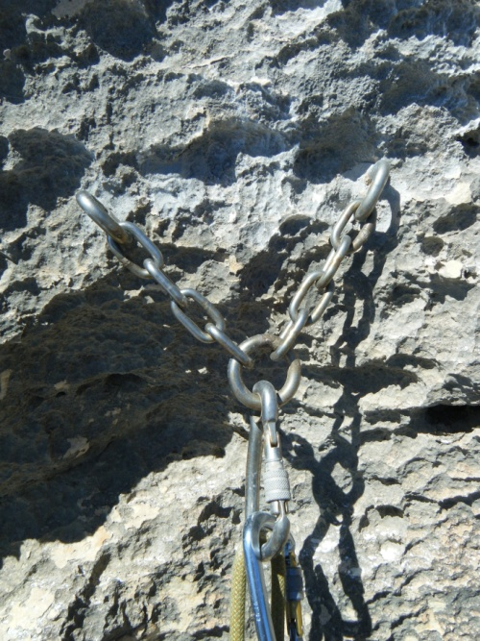
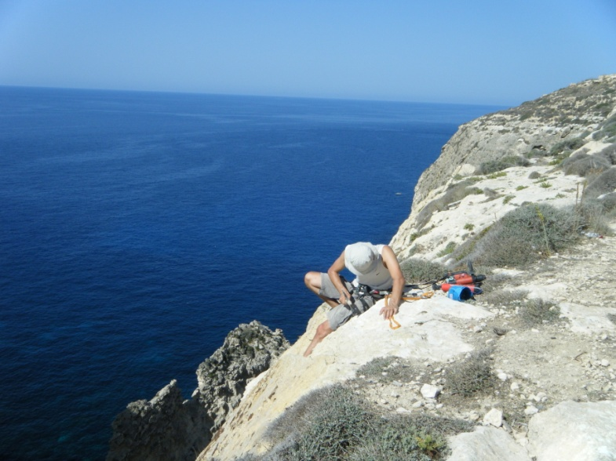
Bolting Work and New Routing
Lower-offs installed on 43 routes

Slide 46
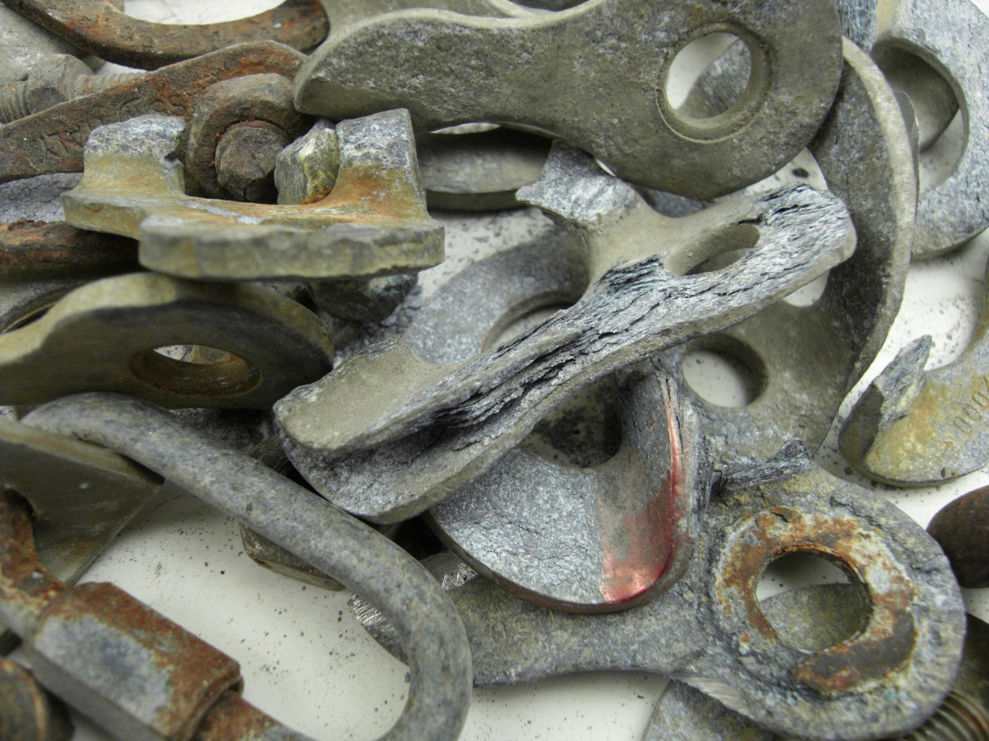
Bolting Work and New Routing
90+ bolts installed by MRCC Bolting Team
50+ MTA-MRCC bolts installed by other local climbers

Slide 47
Photoshoots, Newspapers & Film
Presentation to Everest Summiteers - Jan
Times article re Bolting work (print, online, film) - Feb
Telezeuri Filming - Jun
David Simmonite photoshoot - Oct
Photoshoot with Pareti journalists - Nov
Filming of MTA video with Bryan Azzopardi - Nov
Media coverage of Victoria Lines initiative - Dec
Articles for local, UK & European climbing magazines

Slide 48
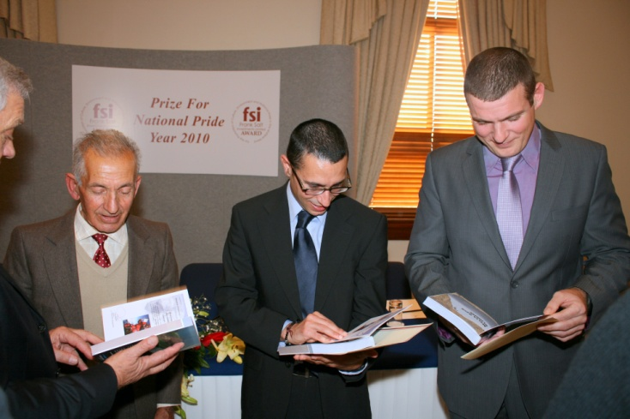
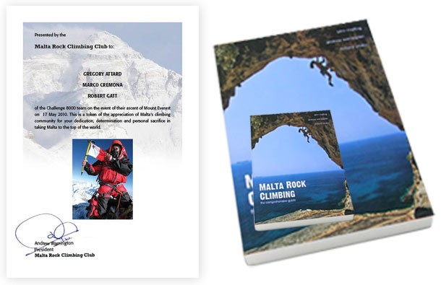
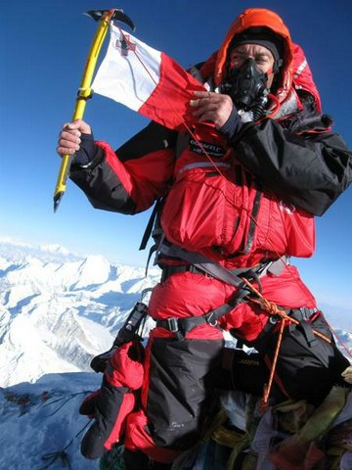
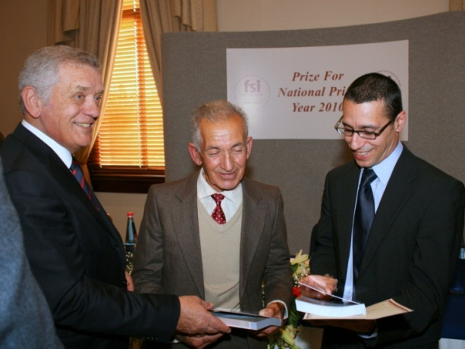
Photoshoots, Newspapers & Film
Presentation to Everest Summiteers - Jan

Slide 49
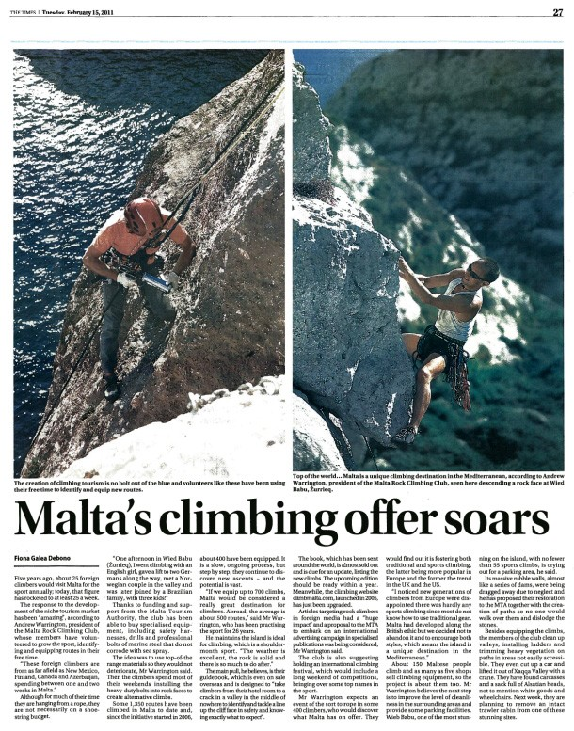
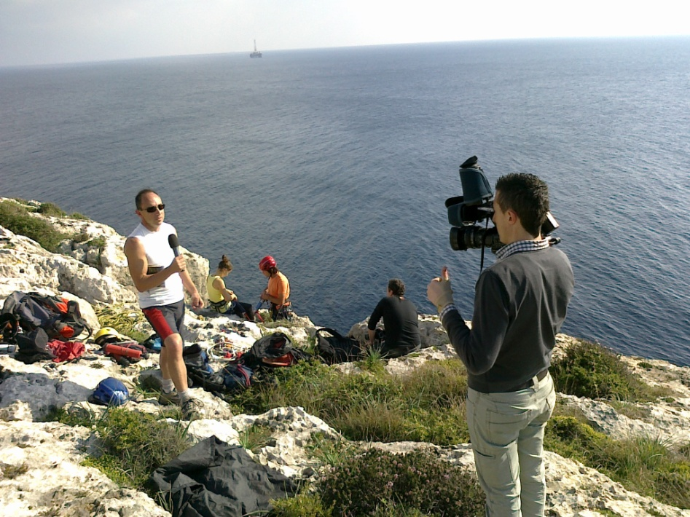
Photoshoots, Newspapers & Film
Times article re Bolting work (print, online, film) - Feb

Slide 50
Photoshoots, Newspapers & Film
David Simmonite photoshoot - Oct

Slide 51
Photoshoots, Newspapers & Film
Photoshoot with Pareti journalists - Nov

Slide 52
Photoshoots, Newspapers & Film
Filming of MTA video with Bryan Azzopardi - Nov

Slide 53
Photoshoots, Newspapers & Film
Media coverage of Victoria Lines initiative - Dec

Slide 54
Photoshoots, Newspapers & Film
Articles for local, UK & European climbing magazines
The Malta Independant Daily
L-Orizzont

Slide 55
Website & New Facebook Group
Website updated 70 times
with news of events and activities
Replaced old Facebook Fanpage with Group Page

Slide 56
Website & New Facebook Group
www.climbmalta.com

Slide 57
Website & New Facebook Group

Slide 58
Relationship Building with Stakeholders
New Environmental Projects & bolting initiatives for 2012 being finalised
Cooperative initiatives between MRCC and various government bodies and NGOs

Slide 59
What they are saying about us...
“
Thank you so much for all your upkeep of all the crags throughout Malta! I made very good use of your bolts.
Thanks for your work on the guide book by the way, it is the best guide book I've ever seen. Great pictures, route descriptions, and all the information was laid out in a very organized manner. It was indispensable during the last trip.
“
Paul Sammut, Facebook 27th Dec 2011

Slide 61
Sophia Zozime from Alpha School of English for compiling this Presentation
All the Committee and Club members who have dedicated their time and efforts towards all these achievements
To my Paddy for putting up with my climbing addiction
Everyone who came today to celebrate another year of the MRCC
Thanks to…

